Slide 1
Detection of Insider Threat Behavior Patterns: A Data Driven Approach Using Power BI
Submitted in the partial fulfillment for the award of the degree of
BACHELOR OF ENGINEERING
IN
CSE(INFORMATION SECURITY)
Submitted by:
SHUBAHM PATEL(22BIS50002)
LALIT(22BIS50004)
SHASHWAT SHARMA(22BIS50005)
Under the Supervision of:
Sheetal Laroiya
Department of AIT-CSE
DISCOVER . LEARN . EMPOWER

Slide 2
Outline
Introduction
Objective
Key Components
Project Overview
Problem Formulation
Block Diagram
Result

Slide 3
Introduction
Growing Security Challenge:- Organizations face increasing risks from insider threats as employees have greater access to sensitive data and systems than ever before.
Data-Driven Solution:- This project introduces a systematic approach to detect suspicious behavior patterns by analyzing user activity data through Power BI's powerful analytics capabilities.
Proactive Detection:- By identifying anomalous patterns early, organizations can prevent data breaches, intellectual property theft, and other malicious activities before significant damage occurs.

Slide 4
Objectives
Establish Behavioral Baselines:-
Create comprehensive profiles of normal user behavior patterns across different roles, departments, and access levels within the organization.
Detect Anomalous Activities:-
Identify deviations from established baselines that may indicate malicious intent, including unusual access times, excessive data downloads, or unauthorized system access.
Implement Real-Time Monitoring:-
Deploy continuous surveillance capabilities that analyze user activities as they occur, enabling immediate detection of potential threats.

Slide 5
Objectives
Provide Actionable Insights:-
Deliver clear, visual representations of threat indicators through Power BI dashboards that enable security teams to make informed decisions quickly.
Reduce False Positives:-
Refine detection algorithms to minimize false alarms while maintaining high sensitivity to genuine insider threat behaviors.

Slide 6
Key components
Data Collection: Gathering comprehensive user activity logs, access records, file transfers, email communications, and system interactions across the organization's infrastructure.
Data Integration: Consolidating data from multiple sources into a unified Power BI environment for seamless analysis and correlation of events.
Pattern Analysis: Applying statistical methods and machine learning algorithms to identify baseline behaviors and detect deviations that may indicate insider threats.
Visualization Dashboard: Creating interactive Power BI dashboards that present threat indicators, risk scores, and behavioral anomalies in an intuitive, actionable format.

Slide 7
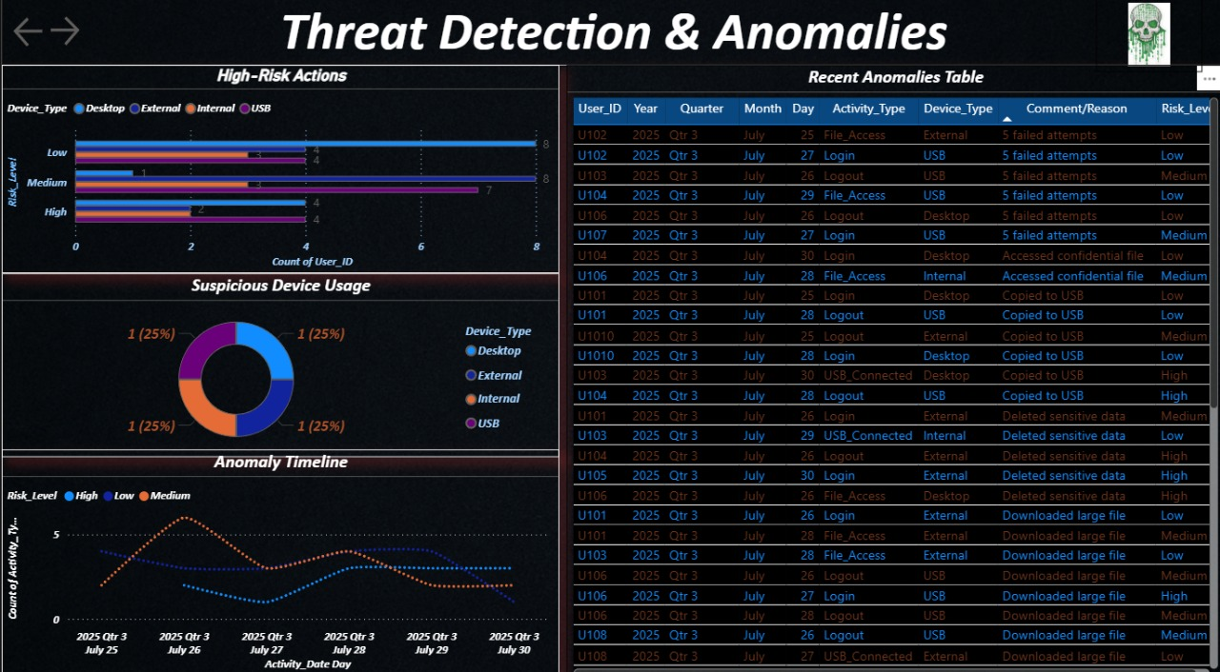
Project Overview

Slide 8
Problem Formulation
The Challenge:
Traditional security measures focus primarily on external threats, leaving organizations vulnerable to malicious insiders who exploit their authorized access.
The Solution
Develop an automated, data-driven detection system that continuously monitors user behavior and identifies anomalies indicative of insider threats.

Slide 9
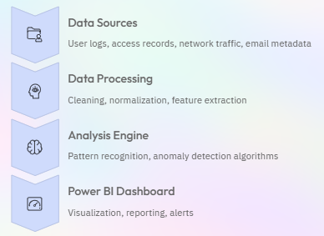
Block Diagram

Slide 10
Result
The Power BI-based system successfully identified insider threat patterns with high accuracy, demonstrating the effectiveness of data-driven approaches in cybersecurity.
Interactive dashboards provided security teams with clear visualizations of risk indicators, enabling faster response times and more informed decision-making.
The framework can be adapted to organizations of various sizes and industries, offering a flexible approach to insider threat detection.

Slide 11
Thankyou

